Slide 1
Name: Ibne Hassan
ID : 22241121
Section : 02
Paper Review on :
An analysis of graph convolutional networks and recent datasets for visual question answering
https://doi.org/10.1007/s10462-022-10151-2
Team 13
ST Abid Hossain
RA Sania Azhmee Bhuiyan

Slide 2
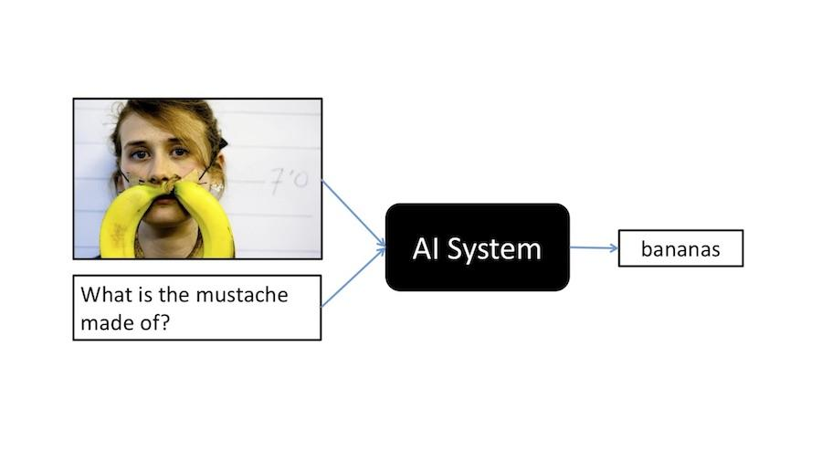
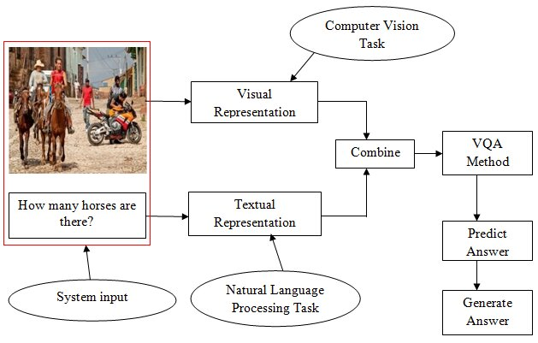
Visual Question Answering

Slide 3
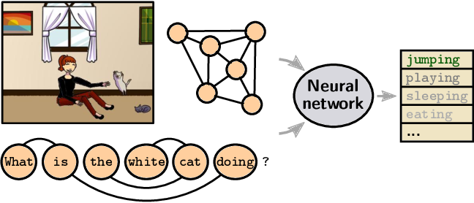
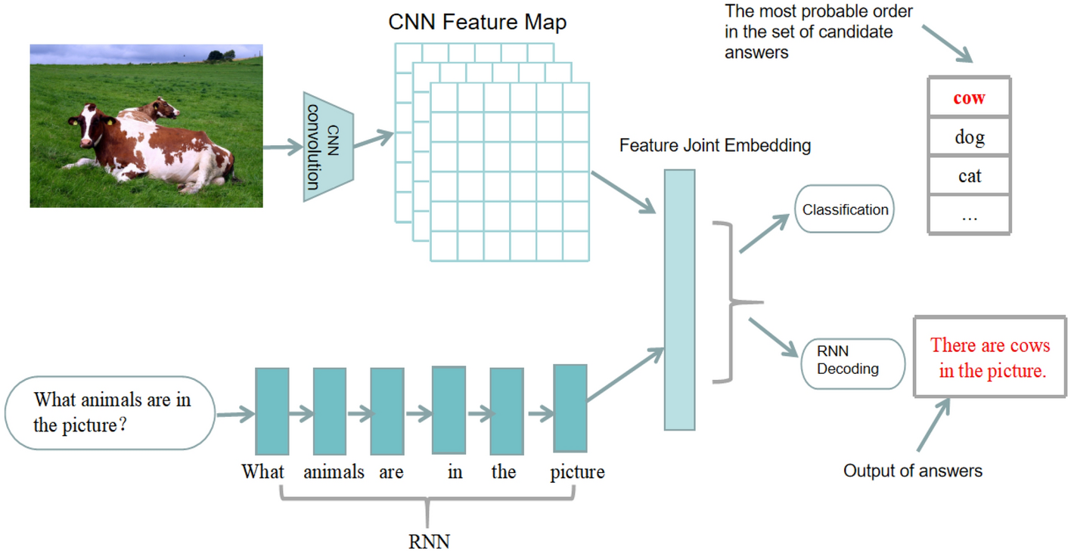
Graph neural networks for visual question answering

Slide 4
Datasets
Visual question answering version 2.0 (VQA 2.0)
Fact‑based visual question answering (FVQA)
Graph question answering (GQA)
TextVQA
Visual question answering 360° (VQA 360°)
VizWiz

Slide 5
Critical Review
Datasets :
• should be sufficient to capture question and image concepts in natural settings.
• Should have a fair evaluation scheme to validate different VQA models.
• should be minimally biased.
VQA Challenges
Visual question answering challenges
Image quality and size
Inconsistent answers
Reasoning type of questions
Multiple words in answers
Answering number specific question

Slide 6
Conclusion and further studies
GCN is a quite new and powerful network architecture for generalizing CNN to graph structured data.
Examine to improve the performance of VQA results using graph-based approach.

